Slide 1
Climate Change, Greenhouse gas accounting & Product carbon footprints
Zeller + Gmelin GmbH & Co. KG
Internationale Gesamtvertriebstagung 2024
Schwäbisch Gmünd
Prof. Dr. Bastian Schröter, HFT Stuttgart

Slide 2
Some words about your presenter
Professor of Energy Technology, HFT Stuttgart (since 2016)
Center for Sustainable Energy Technology, head
Chief Sustainability Officer
Co-Founder of consulting practice Edenberg UG, Stuttgart
McKinsey & Co. and Siemens Corporate Research, Munich (2008-14, 2014-16)
Ph.D., Environmental Science Center, U Augsburg (2012)
M.Sc., Physics, U Jena, U Grenoble, LMU Munich (2007)
Source (picture): https://visme.co/blog/wp-content/uploads/2016/11/

Slide 3
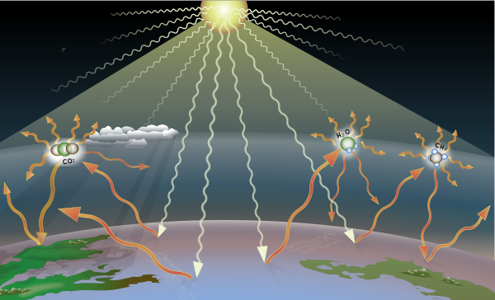
Greenhouse gases in the Earth‘s atmosphere scatter infrared light back to the surface, keeping our planet from freezing
Earth reflects solar irradiation as infrared light (IR) back into space
Greenhouse gases reflect IR back to Earth
Without greenhouse gases, the global average temperature would be -18 °C instead of 15°C
Source of graph: Wikimedia Creative Commons

Slide 4
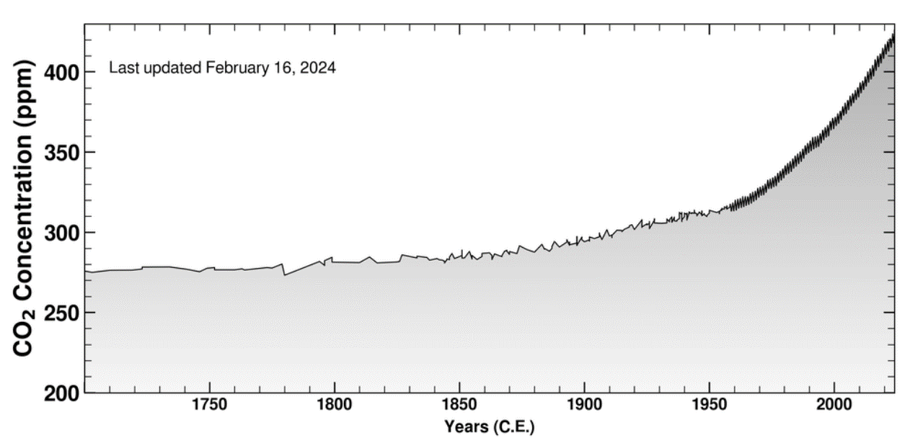
Since 1850, atmospheric CO₂ levels have increased by 50%
Pre-industrial CO₂ concentration: 280 ppm
2°C goal: ~450 ppm
+2°C : like fever of 38.5°C – incon-venient, but not yet deadly
ca. +50%
Source of graph: The Keeling Curve, UC Santa Barbara (https://keelingcurve.ucsd.edu)

Slide 5
To combat global warming, countries, states and cities have set “net zero” targets
EU: 2050
Net zero: no net emissions into the atmosphere on a yearly basis
EU: -55% in 2030, -90% in 2040 (maybe), compared to 1990 levels, net zero by 2050
Germany: -65% by 2030 (compared to 1990), net zero by 2045
Baden-Württemberg: net zero by 2040
Stuttgart: net zero by 2035
Germany: 2045
BW: 2040
Stuttgart: 2035

Slide 6
To support climate targets, countries have enacted legislation to price carbon and/or subsidize the shift to green alternatives
EU: focus on carbon pricing
USA: focus on subsidies
EU Emission Trading Scheme (ETS)
Large GHG emitters need allowances; share of free allowances decreases year by year
Transport and building sectors to be part of an ETS 2 from 2027
Cross-border adjustment mechanism (CBAM)
Embedded GHG emissions priced into goods imported from outside the EU from 2026
Inflation Reduction Act
$400 billion federal funding to climate-related efforts (energy, agriculture, transport…)
Mix of grants, tax incentives, loan guarantees
State legislation
E.g. California: carbon trading scheme, fuel standards, etc.
Sources: European Commission, EU ETS 2 and CBAM (https://climate.ec.europa.eu/eu-action/eu-emissions-trading-system-eu-ets, https://taxation-customs.ec.europa.eu/carbon-border-adjustment-mechanism_en); MCKinsey 2023 (https://www.mckinsey.com/industries/public-sector/our-insights/the-inflation-reduction-act-heres-whats-in-it)
Notes:
Transitional period of the CBAM between 1 October 2023 and 31 December 2025
The IRA directs nearly $400 billion in federal funding to clean energy, with the goal of substantially lowering the nation’s carbon emissions by the end of this decade. The funds will be delivered through a mix of tax incentives, grants, and loan guarantees. Clean electricity and transmission command the biggest slice, followed by clean transportation, including electric-ve
(https://www.mckinsey.com/industries/public-sector/our-insights/the-inflation-reduction-act-heres-whats-in-ithicle (EV) incentives.)

Slide 7
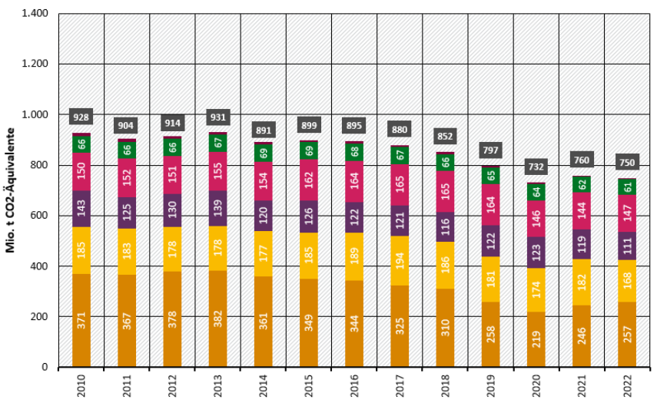
To date, GHG emissions reductions mostly stem from the energy sector, with still little contribution from mobility or industry
Most GHG emission reductions in energy and, to a lesser extent, buildings
Industry and transport emissions did hardly change
Mio. t CO₂ equivalents
Energy
Indus- try
Buil- dings
Trans-port
Agri-cultture
Waste and other
Source of graph: Umweltbundesamt, 15.01.2024

Slide 8
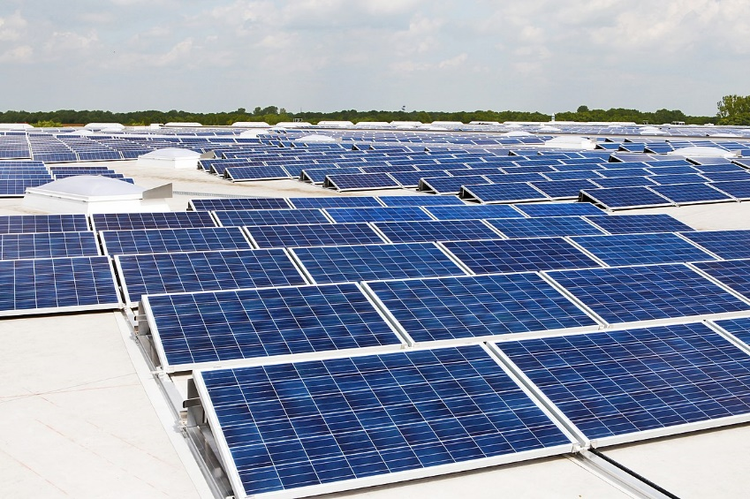
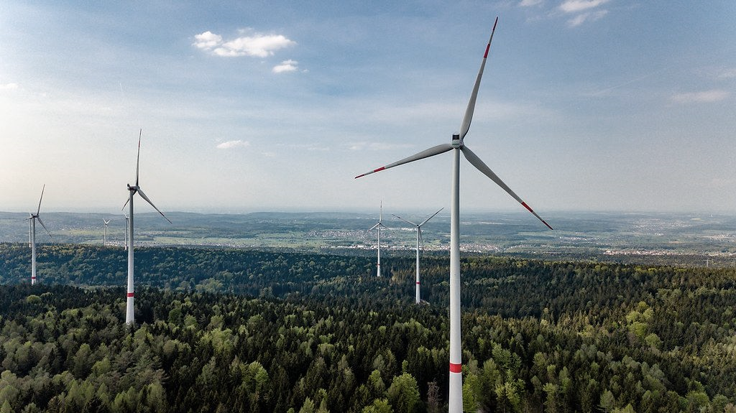
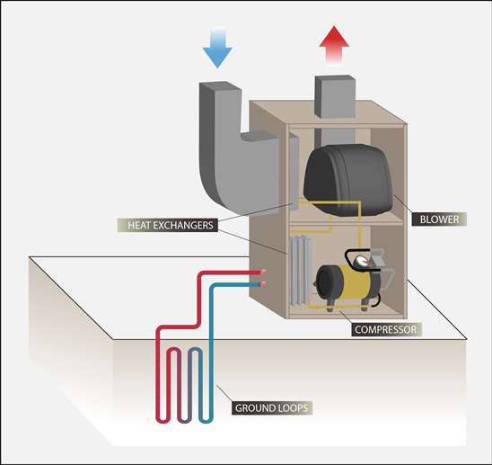
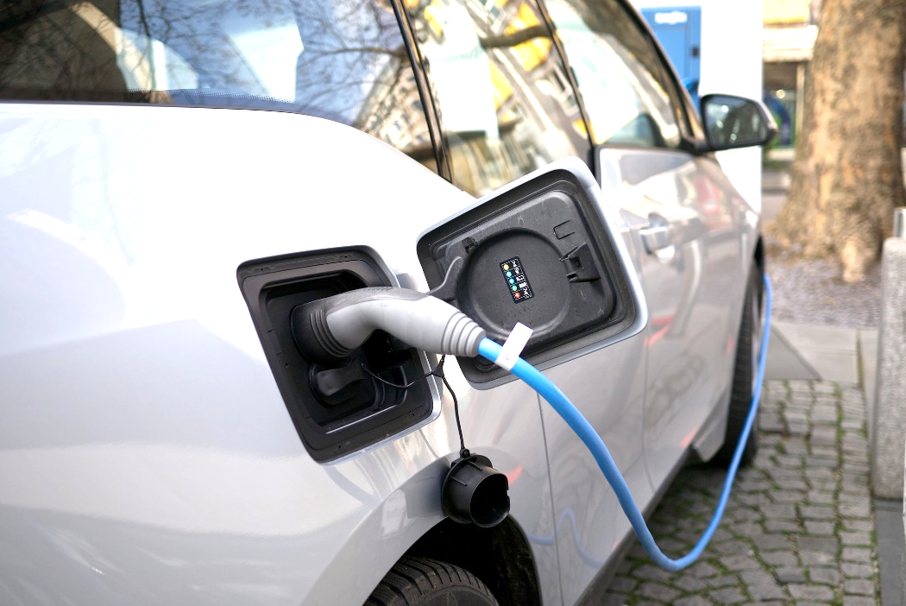
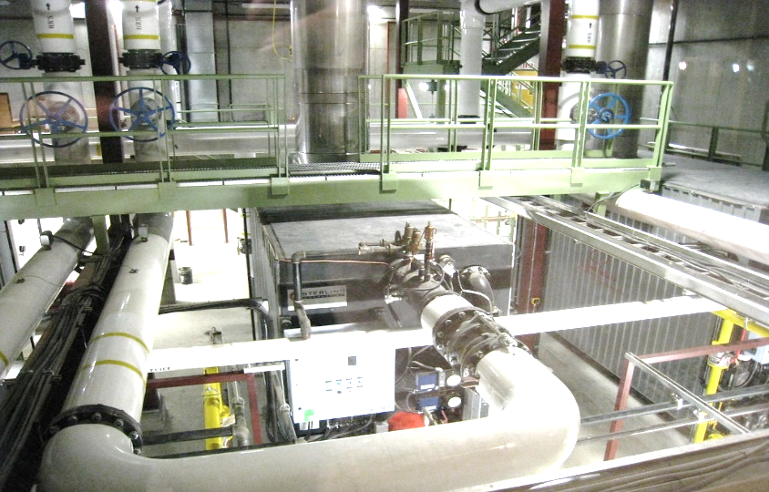
A range of GHG emission reduction measures in industry is available – and often commercially viable
Sources of graphs: Wikimedia Creative Commons (PV panel); led-lighting-world.blogspot.com (LED); www.scirp.org (heat pump) ; australiansolarquotes.com.au (EV); foto.wuestenigel.com (Wind); flickr.com (wastewater heat recovery)

Slide 9
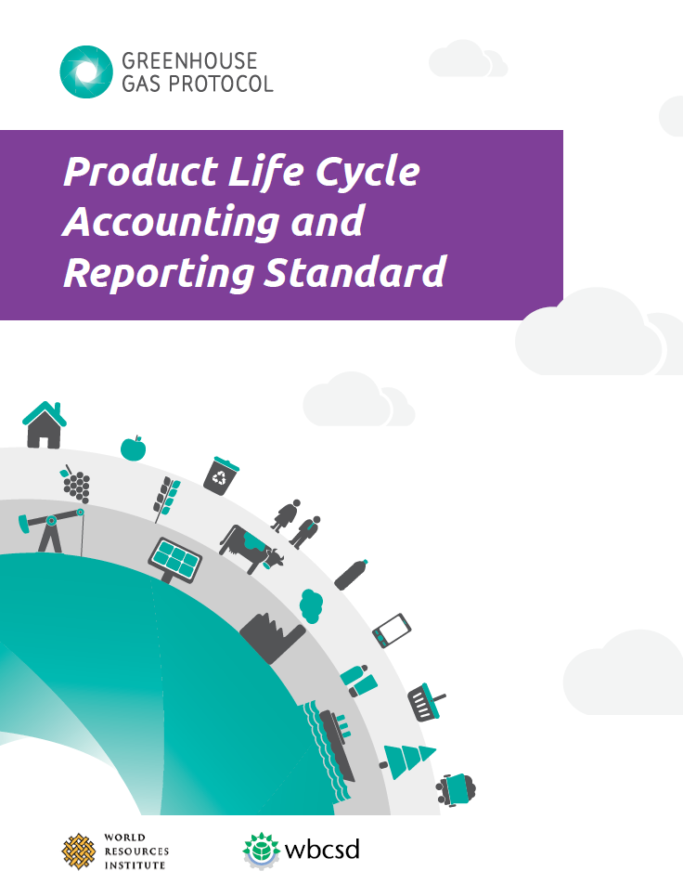
Emission reduction plans require standardized controlling of (yearly) GHG emissions
… which require emissions tracking
… require measures to achieve them
2050/45/40 „net zero“ goals…
Source of graph: GHG Protocol

Slide 10
A distinction must be made between Corporate and Product Carbon Footprints
Upstream value chain
Company‘s value add
Downstream value chain
Corporate view:
A company's activities require energy - which leads to (in)direct GHG emissions
Product view: multiple companies and the end user contribute to a product carbon footprint
Cradle to inbound gate
… to outbound gate
… to grave

Slide 11
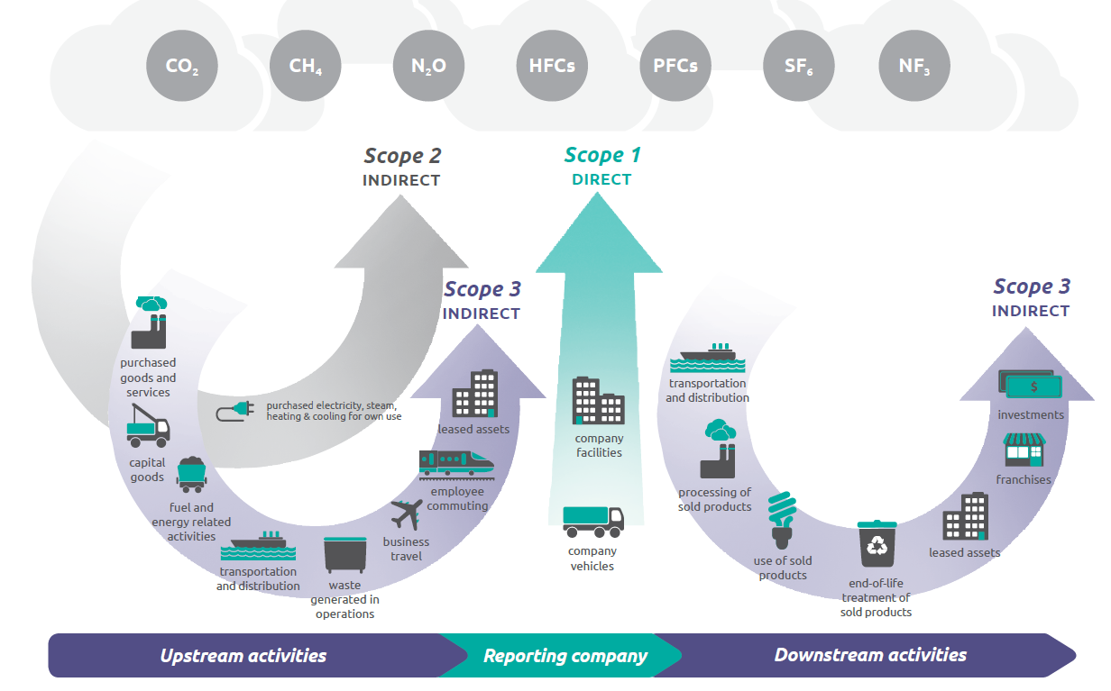
The Corporate Carbon Footprint focuses on GHG emissions within a company’s own control
GHG Protocol: definition of Scopes 1-3
Scopes 1+2 are man-datory within the GHG Protocol
Scope 3 is optional; categories differ con-siderably in terms of
“closeness” to Scopes 1+2
complexity
data availability
Scope 3 categories close to the corporate carbon footprint
Bastian Schröter | Z+G Sales Conference | 29.02.2024 I Slide 11
Source: Greenhouse Gas Protocol, Technical Guidance for Calculating Scope 3 Emissions

Slide 12
Many large companies have by now assessed their Corporate Carbon Footprint, including Scope 3 elements
Scope 1
Scope 2
Scope 3
Scope 1:
151 t CO₂e p.a.
Scopes 1+2:
254 t CO₂e p.a.
Scope 1-3:
504 t CO₂e p.a.

Slide 13
However, Product Carbon Footprints can be much larger than Corporate Carbon Footprints
Product carbon footprints can be 5x larger than an OEM‘s contribution
Raw material footprints are almost always material
Transport is often a rather minor factor
Raw mater-ials
Pre-pro-duc-tion
In. Trans-port
OEM contri-bution
Out. trans-port
Use
End of life

Slide 14
For suppliers, Product Carbon Footprints should focus on upstream activities
GHG Protocol, supplier product carbon footprint: relevant Scope 3 categories
Relevant PCF categories for suppliers
For suppliers, calculating “cradle-to-grave” footprints is challenging to impossible
Focus should thus be upstream, i.e. “cradle-to-outbound gate”
Categories close to corporate footprint
Bastian Schröter | Z+G Sales Conference | 29.02.2024 I Slide 14
Source: Greenhouse Gas Protocol, Technical Guidance for Calculating Scope 3 Emissions

Slide 15
Calculating a Product Carbon Footprints is not complicated –in principle
What you need to know to calculate a cradle to outbound Product Carbon Footprint
1. Your corporate carbon footprint (CFA)
2. How to allocate your CFA to outputs
3. Where your ingredients/inputs come from, and where your products are delivered to
4. Emission factors for your ingredients/inputs
… and the rest is multiplication.
Source of graph: GHG Protocol, UEIL

Slide 16
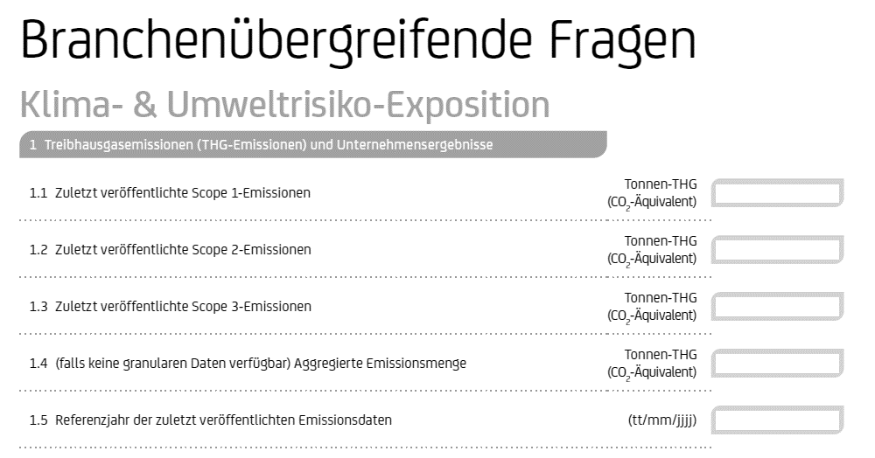
Regulation mandates stakeholders to further push for corporate and product carbon footprint data points
Corporate Sustaina-bility Reporting Directive (CSRD)
Mandates non-SMEs to start sustainability reporting by 2028 the latest.
Includes information on, e.g., Corporate Carbon Footprint, with scope 3 emissions
1
2
EU taxonomy rules for banks
Require a sustain-ability assessment of, e.g., credit portfolios („Green Asset Ratio“) – and thus their customers‘ footprints
Notes:
Der Inhalt der Nachhaltigkeitsberichterstattung wird durch die European Sustainability Reporting Standards (ESRS) konkretisiert.
(BAFIN)
Relevanz Klimawandel: „Kommt ein Unternehmen zu dem Schluss, dass der Klimawandel nicht wesentlich ist, und lässt es daher die Angaben zu diesem Standard aus, muss es eine detaillierte Erläuterung der Schlussfolgerungen seiner Bewertung der Wesentlichkeit in Bezug auf den Klimawandel vorlegen. Diese Bestimmung entspricht den weitreichenden und systemischen Auswirkungen des Klimawandels auf die gesamte Wirtschaft.“
(https://ec.europa.eu/commission/presscorner/detail/de/qanda_23_4043)

Slide 17
Many thanks for your attention! … and maybe there are some questions?

